Slide 1
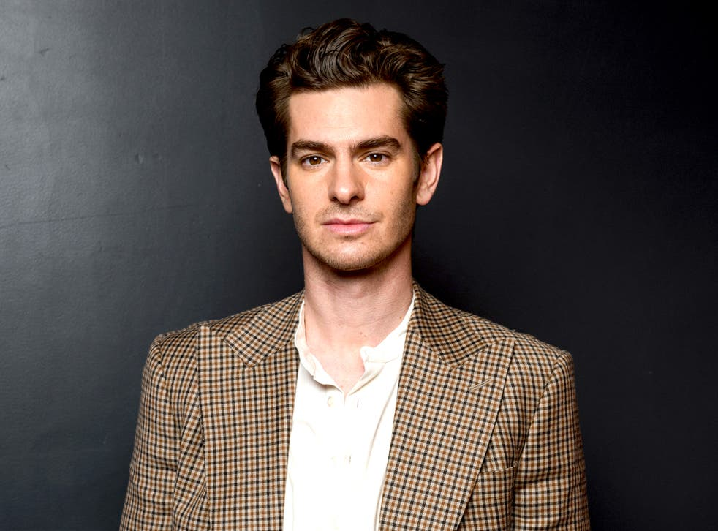
Head Of Hot Beans
Antony Bronson
Meet the head of Hot Beans, the person that is in charge of the company and makes the business going with his amazing leadership.

Slide 2
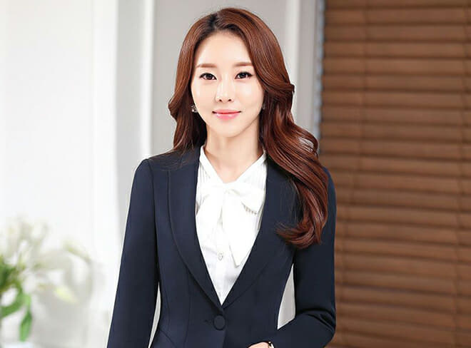
Head Of Web Development
Ema Yoshida
Ema is a crucial part of the Hot Beans team and without developers like her, the company wouldn’t be able to produce outstanding content.

Slide 3
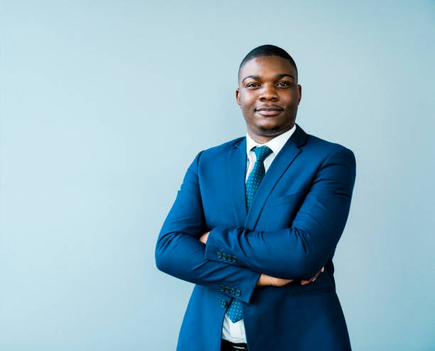
Developer Director
Aaron Davis
Aaron is the development director and manages web development projects, ensuring they are done on time and meet the businesses standards.

